Slide 1
Unit 1 Cascading Style Sheets (CSS)
Ms. Divya Singhal
Assistant Professor
KIET Group of Institutions, Delhi- NCR, Ghaziabad

Slide 2
Outline
Introduction to CSS
What is CSS?
Importance of CSS
Basics of CSS
Basic Syntax & Structure
Class & ID
Types of CSS
Multiple selector, Multilevel selector
Background
Fonts & Text

Slide 3
Outline (Cont.)
Box Model
Margin, Border, Padding
List
List Type, List with Image, List Position
Links
CSS Positioning
CSS Layers
CSS Floating Property
Introduction to CSS3

Slide 4
What is CSS?
Cascading Style Sheets, fondly referred to as CSS, is a simple design language intended to simplify the process of making web pages presentable.
CSS defines layout of HTML documents. For example, CSS covers Fonts, colors, margins, lines, height, width, background images, advanced positions and many other things.

Slide 5
Importance of CSS
CSS defines HOW HTML elements are to be displayed.
Styles are normally saved in external .css files.
External style sheets enable you to change the appearance and layout of all the pages in a Web site, just by editing one single file.
Advantages :
Improves Website Presentation
External CSS makes Updates Easier and Smoother
External CSS helps Web Pages Load Faster
Disadvantages :
Browser Dependent
Difficult to retrofit in old websites

Slide 6
Basic Syntax of CSS
A CSS rule has two main parts: a selector, and one or more declarations
The selector can be HTML element, id or class.
Each declaration consists of a property and a value.
The property is the style attribute you want to change. Each property has a value.
Selector
Declaration 1
Declaration 2
h1
{color:blue; font-size: 12px;}
property
value
property
value

Slide 7
The “id” selector
The id selector is used to specify a style for a single, unique element.
The id selector uses the id attribute of the HTML element, and is defined with a "#“ in css.
The style rule below will be applied to the element with id="para1":
HTML
<h1 id=“para1”>
Hello Friends
</h1>
<h1>
How are you
</h1>
CSS
#para1{
color: blue;
}
Output
Hello Friends
How are you

Slide 8
The “class” selector
The class selector is used to specify a style for a group of elements.
The class selector uses the HTML class attribute, and is defined with a ".“ in css.
HTML
<h1 class=“myClass”>
Hello Friends
</h1>
<h1>
How are you
</h1>
<h1 class=“myClass”>
How are you
</h1>
CSS
.myClass{
color: blue;
}
Output
Hello Friends
How are you
How are you
Element_with_class.html
Selector.html

Slide 9
Different ways to write CSS
There are three ways of writing a style sheet:
Inline Style
Internal/Embedded Style sheet
External Style Sheet

Slide 10
1) Inline Style
It is possible to place CSS right in your HTML code, and this method of CSS usage is referred to as inline css.
Inline CSS has the highest priority out of external, internal, and inline CSS.
This means that you can override styles that are defined in external or internal by using inline CSS.
If you want to add a style inside an HTML element all you have to do is specify the desired CSS properties with the style HTML attribute.
Example:
HTML
<p style="background: blue; color: white;"> My Inline CSS </p>

Slide 11
2) Internal Style Sheet
This type of CSS is only for Single Web Page.
When using internal CSS, we must add a new tag, <style>, inside the <head> tag.
The HTML code below contains an example of <style>'s usage.
HTML
<html><head>
<style type="text/css">
p{ color: red;}
</style>
</head><body>
<p>Your page's content!</p></body>
</html>

Slide 12
3) External Style Sheet
When using CSS it is preferable to keep the CSS separate from your HTML.
Placing CSS in a separate file allows the web designer to completely differentiate between content (HTML) and design (CSS).
External CSS is a file that contains only CSS code and is saved with a ".css" file extension.
This CSS file is then referenced in your HTML using the <link> instead of <style>.

Slide 13
3) External Style Sheet (Cont.)
Example :
Demo.html
<html>
<head>
<link rel=“stylesheet” type=“text/css” href=“test.css”>
</head>
<body>
<p> Hello Friends </p>
<p id=“para1”> How are you? </p>
</body>
</html>
test.css
#para1{
text-align: center;
}
p
{
color : blue;
}
Output
Hello Friends
How are you?

Slide 14
3) External Style Sheet (Cont.)
Advantages:
It keeps your website design and content separate.
It's much easier to reuse your CSS code if you have it in a separate file. Instead of typing the same CSS code on every web page you have, simply have many pages refer to a single CSS file with the "link" tag.
You can make drastic changes to your web pages with just a few changes in a single CSS file.

Slide 15
Assign Multiple Classes
We can apply different class to same html element by giving space separated class names in the class attribute:
Demo.html
<html>
<head>
<link rel=“stylesheet” type=“text/css” href=“test.css”>
</head>
<body>
<h1 class=“class1 class2”>
How are you?
</h1>
</body>
</html>
test.css
. class1
{
color : blue;
}
. class2
{
text-align : center;
}
Output
How are you?

Slide 16
Multiple Selection
We can apply same css to multiple selectors using comma separated selector list, for example :
Demo.html
<html>
<head>
<link rel=“stylesheet” type=“text/css” href=“test.css”>
</head>
<body>
<p> Hello Friends </p>
<h1> How are you? </h1>
</body>
</html>
test.css
p, h1
{
color : blue;
}
Output
Hello Friends
How are you?

Slide 17
Multi-level Selection
We can use hierarchical path to target html element by space separated element/class/id names, for example :
Demo.html
<html>
<head>
<link rel=“stylesheet” type=“text/css” href=“test.css”>
</head>
<body>
<h1>Hello Friends…</h1>
<div>
<h1>How are you?</h1>
</div>
</body>
</html>
test.css
div h1
{
color : blue;
}
Output
Hello Friends…
How are you?

Slide 18
Background Property
Background Color (background-color)
Background Image (background-image)
Background Image Repeat (background-repeat)
Fixed Background Image (background-attachment)
Background Image Positioning (background-position)
Property Name

Slide 19
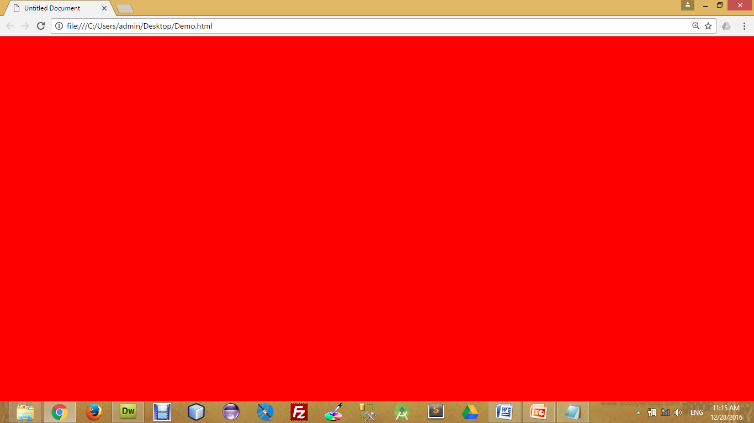
Background Color
The background-color property specifies the background color of an element.
The background color of a page is defined in the body selector:
Below is example of CSS backgrounds
test.css
body
{
background-color : red;
background-color : #FF0000;
background-color : rgb(255,0,0);
}

Slide 20
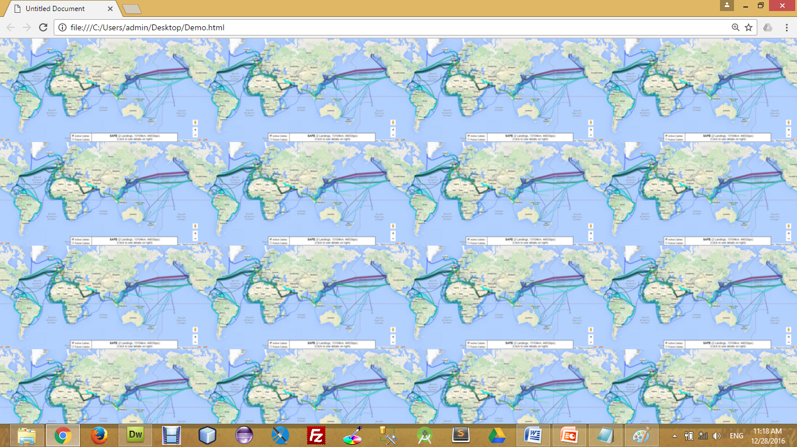

Background Image
The background-image property specifies an image to use as the background of an element.
For Example,
test.css
body
{
background-image : url(‘pathToImage.jpg’);
}

Slide 21
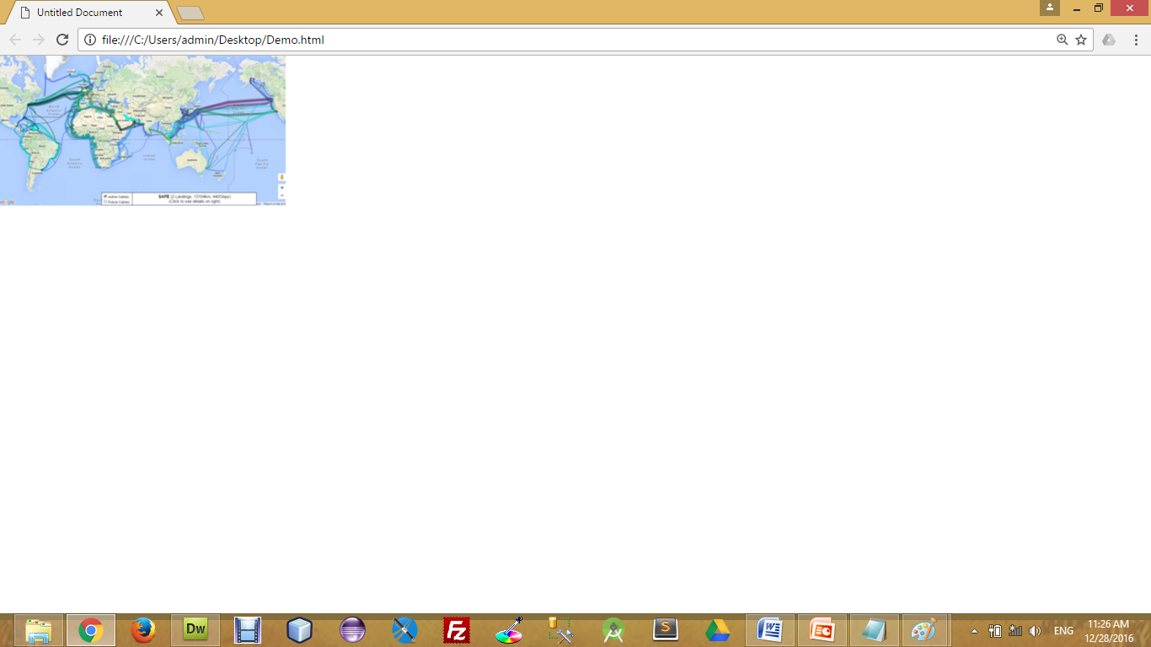
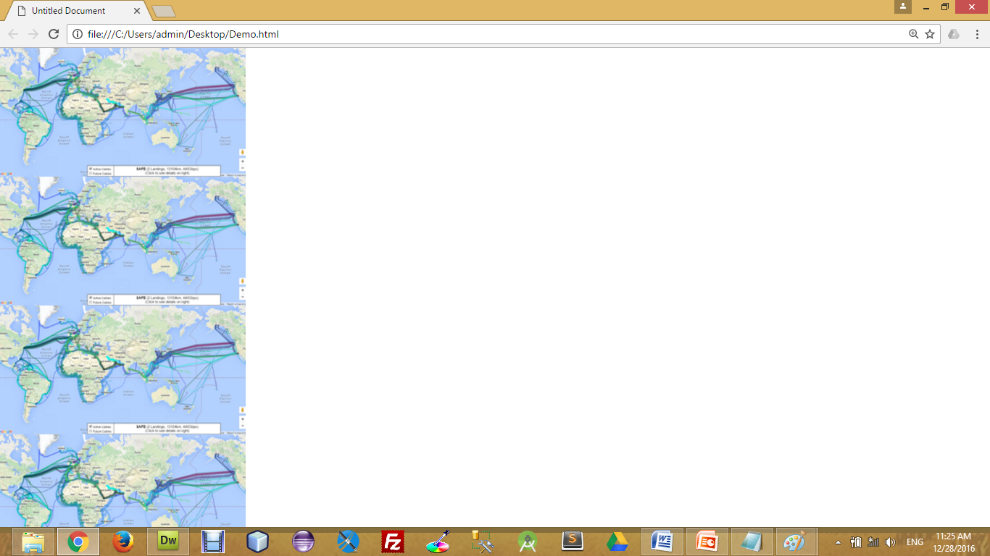
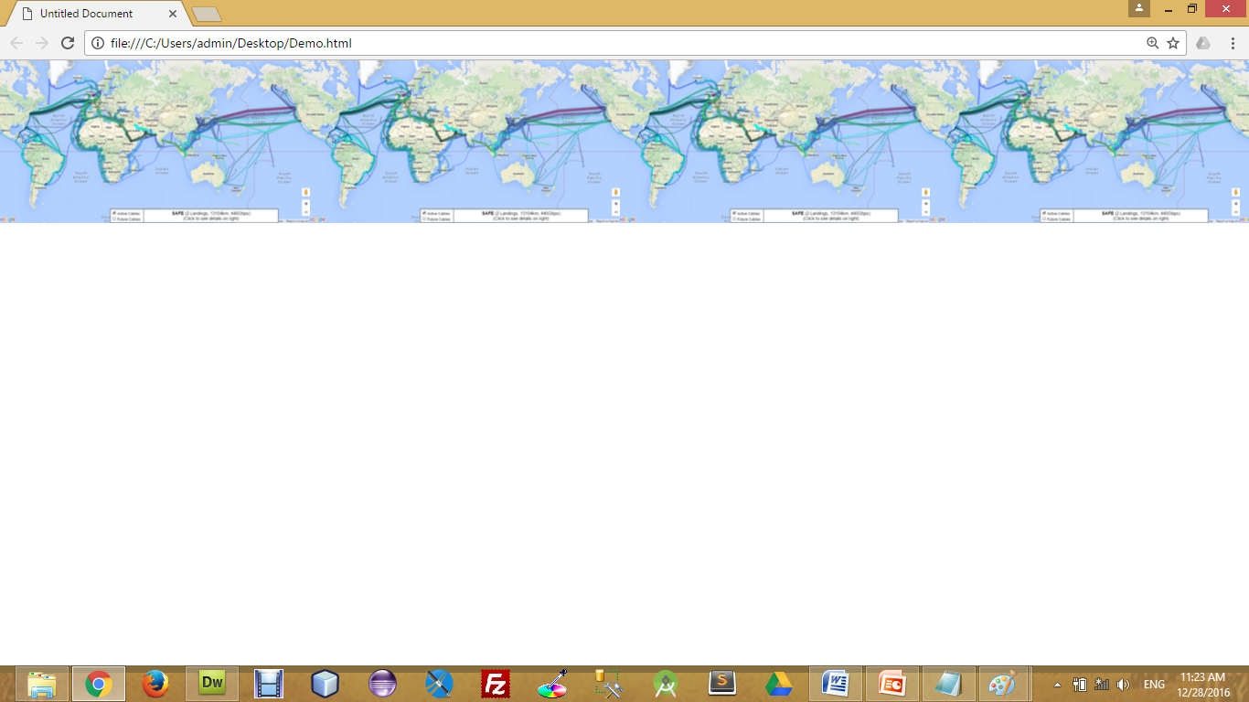
Background Image Repeat
You can have a background image repeat vertically (y-axis), horizontally (x-axis), in both directions, or in neither direction.
test.css
body
{
background-image : url(‘pathToImage.jpg’);
background-repeat : repeat;
background-repeat : repeat-x;
background-repeat : repeat-y;
background-repeat : no-repeat;
}
no-repeat
repeat-y
repeat-x

Slide 22
Fixed Background Image
The background-attachment property sets whether a background image is fixed or scrolls with the rest of the page.
For Example,
test.css
body
{
background-image : url(‘pathToImage.jpg’);
background-repeat : no-repeat;
background-attachment : fixed;
}

Slide 23
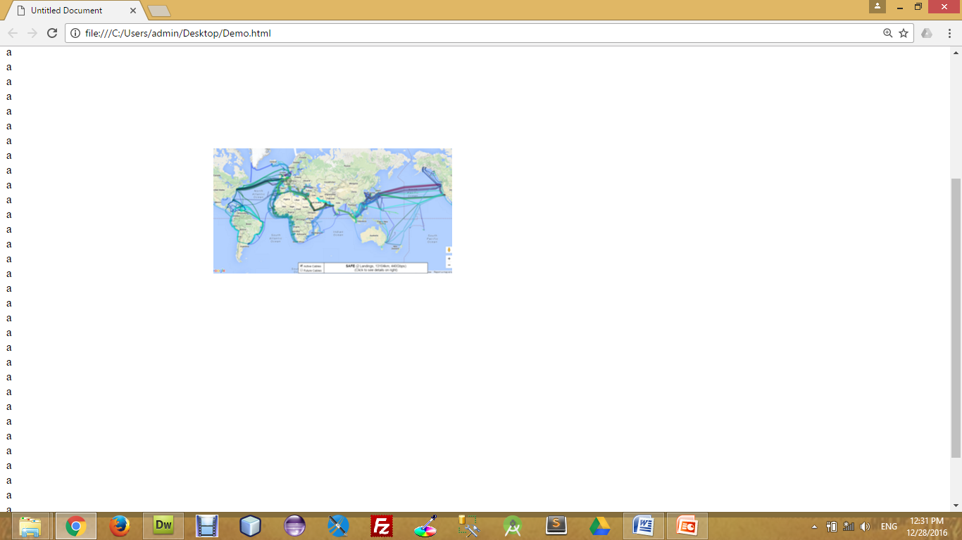
Background Image Positioning
The background-position property sets the starting position of a background image.
test.css
body
{
background-image : url(‘pathToImage.jpg’);
background-repeat : no-repeat;
background-position: 20px 10px;
background-position: 30%30%;
background-position: top center;
}
30% 30%

Slide 24
CSS Font
CSS font properties define the font family, boldness, size, and the style of a text.
Font Color (color)
Font Family (font-family)
Font Size (font-size)
Font Style (font-style)
Font Weight (font-weight)
Font Variant (font-variant)
Property Name

Slide 25
CSS Font (Cont.)
Font Color
Set the text-color for different elements
Font Family
The font family of a text is set with the font-family property.
Font Size
The font-size property sets the size of the text.
font-size : 120%
font-size : 10px;
font-size : x-large;
h4{
color : red;
}
h4{
font-family : sans-serif;
}
h4{
font-size: 120%;
font-size : 10px;
font-size : small;
font-size : smaller;
font-size : x-small;
font-size : xx-small;
font-size : large;
font-size : larger;
font-size : x-large;
font-size : xx-large;
font-size : medium;
}

Slide 26
CSS Font (Cont.)
Font Style
The font-style property is mostly used to specify italic text.
Font Weight
The font-weight property sets how thick or thin characters in text should be displayed.
Font Variant
The font-variant property specifies whether or not a text should be displayed in a small-caps font.
font-variant : small-caps;
h4{
font-style: italic ;
}
h4{
font-weight : 300;
font-weight : bolder;
font-weight : lighter;
}
h4{
font-variant: small-caps;
}

Slide 27
CSS Text Property
While CSS Font covers most of the traditional ways to format your text, CSS Text allows you to control the spacing, decoration, and alignment of your text.
Text Decoration (text-decoration)
Text Indent (text-indent)
Text Align (text-align)
Text Transform (text-transform)
White Space (white-space)
Word Spacing (word-spacing)
Letter Spacing (letter-spacing)
Line Height (line-height)
Property Name

Slide 28
CSS Text Property (Cont.)
Text Decoration
The text-decoration property is used to set or remove decorations from text.
The text-decoration property is mostly used to remove underlines from links for design purposes.
Text Indent
The text-indentation property is used to specify the indentation of the first line of a text.
Text Align
The text-align property is used to set the horizontal alignment of a text.
h4{
text-decoration : line-through;
text-decoration : overline;
text-decoration : underline;
text-decoration : none;
}
h4{
text-indent : 20px;
text-indent : 30%;
}
h4{
text-align : right;
text-align : justify;
text-align : left;
text-align : center;
}

Slide 29
CSS Text Property (Cont.)
Text Transform
The text-transform property is used to specify uppercase and lowercase letters in a text.
White Space
The white-space attribute allows you to prevent text from wrapping until you place a break <br /> into your text.
Word Spacing
With the CSS attribute word-spacing you are able to specify the exact value of the spacing between your words. Word-spacing should be defined with exact values.
h4{
text-transform : capitalize;
text-transform : uppercase;
text-transform : lowercase;
}
h4{
white-space : nowrap;
}
h4{
word-spacing : 10px;
}

Slide 30
CSS Text Property (Cont.)
Letter Spacing
With the CSS attribute letter-spacing you are able to specify the exact value of the spacing between your letters. Letter-spacing should be defined with exact values.
Line Height
The line-height attribute will set the height of the line in the page.
h4{
letter-spacing : 3px;
}
h4{
line-height : 10px;
}

Slide 31
The Box Model
All HTML elements can be considered as boxes. In CSS, the term "box model" is used when talking about design and layout.
The CSS box model is essentially a box that wraps around HTML elements, and it consists of: margins, borders, padding, and the actual content.
The box model allows us to place a border around elements and space elements in relation to other elements.
Box_model_after.html

Slide 32
The Box Model (Cont)
The image below illustrates the box model:
Margin
Border
Padding
Content

Slide 33
The Box Model (Cont)
margin-top
border-top
padding-top
Content
border-right
padding-left
margin-right
margin-left
padding-right
border-left
padding-bottom
border-bottom
margin-bottom

Slide 34
CSS Padding
The CSS padding properties define the space between the element border and the element content.
The top, right, bottom, and left padding can be changed independently using separate properties.
A shorthand padding property can also be used, to change all padding at once.
h4{
padding : 10px;
}
h4{
padding-top : 10px;
padding-right : 20px;
padding-bottom : 30 px;
padding-left : 40 px;
}
h4{
padding : 10px 20px 30px 40px;
}

Slide 35
CSS Border
The CSS border properties allow you to specify the style and color of an element's border.
Border Style Types
The border-style property specifies what kind of border to display.
Border Width
The border-width property is used to set the width of the border.
Border Color
The border-color property is used to set the color of the border.
Border colors can be any color defined by RGB, hexadecimal, or key terms. Below is an example of each of these types.
The top, right, bottom, and left border can be changed independently using separate properties.
h4{
border : 1px solid red;
}
h4{
border-style : solid;
border-style : dotted;
border-style : double;
}
h4{
border-width : 7px;
}
h4{
border-color : red;
}
h4{
border-top : 1px solid red;
}

Slide 36
CSS Margin
The CSS margin properties define the space around elements
The top, right, bottom, and left margin can be changed independently using separate properties.
A shorthand margin property can also be used, to change all margins at once.
h4{
margin: 10px;
}
h4{
margin -top : 10px;
margin -right : 20px;
margin -bottom : 30 px;
margin -left : 40 px;
}
h4{
margin : 10px 20px 30px 40px;
}

Slide 37
CSS List
ul{
list-style-type: circle;
list-style-type: disc;
list-style-type: square;
list-style-type: armenian;
list-style-type: cjk-ideographic;
list-style-type: decimal-leading-zero;
list-style-type: georgian;
list-style-type: hebrew;
list-style-type: katakana;
list-style-type: lower-greek; }
The CSS list properties allow you to:
Set different list item markers for ordered & unordered lists
Set an image as the list item marker
Set the position of the marker
CSS List Style Type
CSS List with Image
CSS List Position
Author.html
ol{
list-style-image : url(‘imgPath’);
}
ol{
list-style-position : outside;
list-style-position : inside;
}

Slide 38
Styling Links
Anchor/Link States
The four links states are:
a:link - a normal, unvisited link
a:visited - a link the user has visited
a:hover - a link when the user mouse over it
a:active - a link the moment it is clicked
a:link{
color:#FF0000; /*unvisited link*/
}
a:visited{
text-decoration : none; /*visited link*/
}
a:hover{
color:#00FF00; /*mouse over link*/
}
a:active{
color:#0000FF; /*selected link*/
}

Slide 39
CSS Positioning
Absolute Positioning
With absolute positioning, you define the exact pixel value where the specified HTML element will appear.
The point of origin is the top-left of the browser's viewable area, so be sure you are measuring from that point.
Relative Positioning
Relative positioning changes the position of the HTML element relative to where it normally appears.
Fixed Positioning
The element is positioned relative to the browser window, in fixed position, element will be in the same place even we scroll the screen.
Static Positioning
It follows the normal document flow, meaning it is placed in the order it appears in the HTML source code and is not affected by properties like top, right, bottom, or left.
h1{
position : absolute;
left : 50px;
top : 100px;
}
h1{
position : relative;
left : 50px;
top : 100px;
}
h1{
position : fixed;
top : 50px;
left : 100px;
}
positioning.html

Slide 40

CSS Layers
CSS allows you to control which item will appear on top with the use of layers.
In CSS, each element is given a priority.
If there are two overlapping CSS positioned elements, the element with the higher priority will appear on top of the other.
To manually define a priority, set the z-index value. The larger the value, the higher the priority the element will have.
CSS
#division1{
position : absolute;
height : 100px;
width : 100px;
left : 100px;
top : 150px;
background-color : red;
z-index : 5;
}
#division2{
position : absolute;
height : 200px;
width : 200px;
left : 50px;
top : 100px;
background-color : blue;
z-index : 2;
}
HTML
<div id="division1">
</div>
<div id="division2">
</div>
Z-index.html

Slide 41
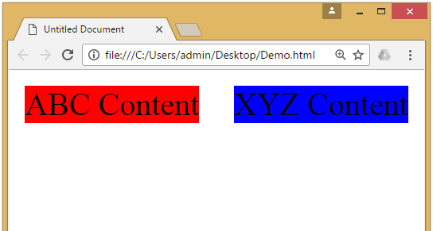
CSS Float Property
The CSS float property defines that an element should be taken out of the normal flow of the document and placed along the left or right side of its containing block.
Text and inline elements will then wrap around this element.
CSS
#division1{
background-color : red;
float : left;
width: 40%;
}
#division2{
background-color : blue;
float : right;
width: 40%;
}
HTML
<div id="division1">
ABC Content
</div>
<div id="division2">
XYZ Content
</div>
Floating_after.html

Slide 42
CSS Clear Property
The clear property in CSS is used to control the behavior of an element concerning floating elements.
When an element is cleared, it will not be allowed to align next to any floating elements that appear before it in the HTML source code.
This property is particularly useful when working with floated elements within a layout.

Slide 43
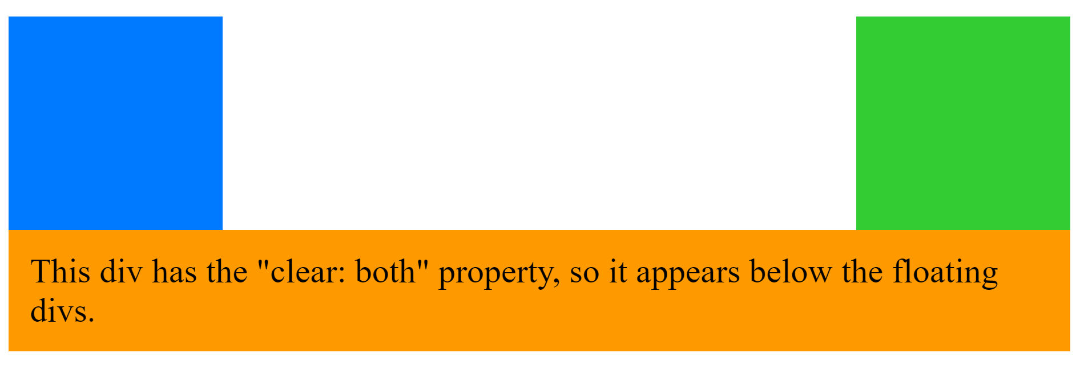
HTML
<div class="float-left"></div>
<div class="float-right"></div>
<div class="clear-both">
This div has the "clear: both" property, so it appears below the floating divs.
</div>
CSS
.float-left {
width: 100px;
height: 100px;
background-color: #007bff;
float: left;
margin-right: 20px;
}
.float-right {
width: 100px;
height: 100px;
background-color: #33cc33;
float: right;
margin-left: 20px;
}
.clear-both {
clear: both;
background-color: #ff9900;
padding: 10px;

Slide 44
Introduction to CSS3
CSS3 is the latest standard for CSS.
CSS3 is completely backwards-compatible with earlier versions of CSS.
CSS3 has been split into "modules". It contains the "old CSS specification" (which has been split into smaller pieces). In addition, new modules are added.
CSS3 Transitions are a presentational effect which allow property changes in CSS values, such as those that may be defined to occur on :hover or :focus, to occur smoothly over a specified duration – rather than happening instantaneously as is the normal behaviour.
Transition effects can be applied to a wide variety of CSS properties, including background-color, width, height, opacity, and many more.

Slide 45
Introduction to CSS3 (Cont)
Some of the most important CSS3 modules are:
CSS Animations and Transitions
Calculating Values With calc()
Advanced Selectors
Generated Content and Counters
Gradients
Webfonts
Box Sizing
Border Images
Media Queries
Multiple Backgrounds
CSS Columns
Courtesy : http://tutorialzine.com/2013/10/12-awesome-css3-features-you-can-finally-use/

